Slide 1
IoT Based Real time Sleep Apnea screening system

Slide 2
Group Members:
Abdur Rab Dhruba 1712441642
Kazi Nabiul Alam 1711217042
Shakib Khan 1711661042
Supervisor: DR. MOHAMMAD MONIRUJJAMAN KHAN
Associate Professor at North South University, PhD, Electrical and Electronic Engineering, Queen Mary University of London, UK B.Eng. Electrical and Electronic Engineering, Queen Mary, University of London, UK.

Slide 3
Background Study & Problem Statement
There are two kinds of Sleep Apnea:
Obstructive Sleep Apnea (OSA)
Central Sleep Apnea (CSA)
According to research, around 3 to 7% of the Male and 2% to 5% of the Female are suffering from sleep apnea that sum up approximately more than 100 million people in the world including adolescents. Interestingly, 80% of Apnea cases remain undiagnosed. Children of around 1 to 4% at age between 2 to 8 suffer from sleep apnea (OSA mostly) and 20% of them snores. It varies in different parameters, like who is affected, who is not.

Slide 4
Existing system review, our proposed solution:
There we found more technical research based on sleep apnea:
Wearable e-textile sensors
Developed the WatchPAT device
Real-time ECG monitoring
Our goal is to measure the maximum of these values like: SpO2, Heart Rate, ECG, Skin response, sound and such parameters at a time. Besides, in earlier research, these values were measured overnight and then they got the data, but we want to make it lively like, if any complications arise, someone concerned may be notified via IoT device..

Slide 5
Output of the project:
we need to know the expected result of those indexes:
Heart Rate: When we sleep, it is expected to be at the low end of normal, or even below; for example, a healthy, fit person can have a heart rate of 50-60 bpm while sleeping. But heart rate of a person with sleep disorders is less than a healthy person’s heart rate.
SpO2: Normal Oxygen saturation level (SpO2) is 94%-95% and 91%-96% is a healthy oxygen saturation level. But during sleep apnea the rate could be drop to below 90%.
ECG: The ECG value changes significantly during sleep apnea, but for healthy person the change is lesser.

Slide 6
Major Milestones
1
2
3
4
Problem designing and proposal.
Finding all equipment.
Circuit Design with the equipment.
Buying the equipment.
Arduino Code.
Hardware Setup.
Completion Hardware part.
Connecting With the Mobile.
Data Analysis.
Testing full project
Report Writing.
Journal Writing.

Slide 7
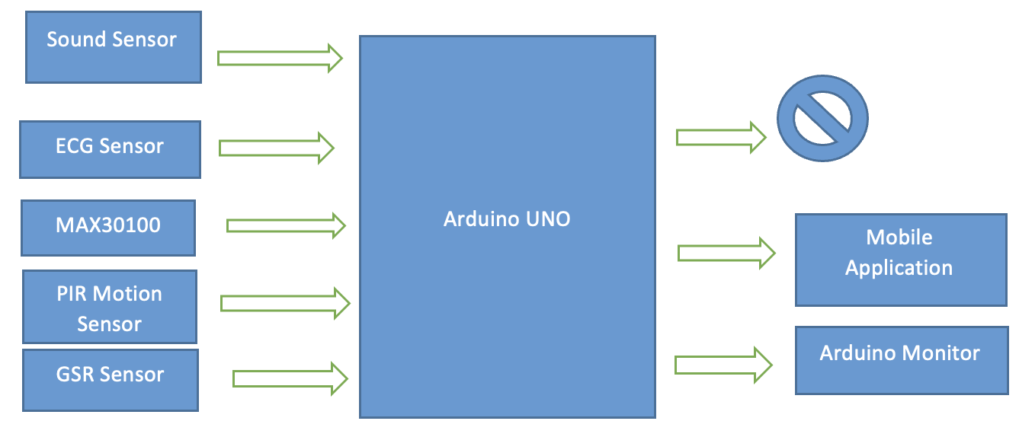
Outline of system
The Arduino board which is also connected with the output layer combined with the serial monitor of the Arduino Board and a MIT App Inventor based mobile application connected with a Bluetooth module to show the converted digital data to the viewer.

Slide 8
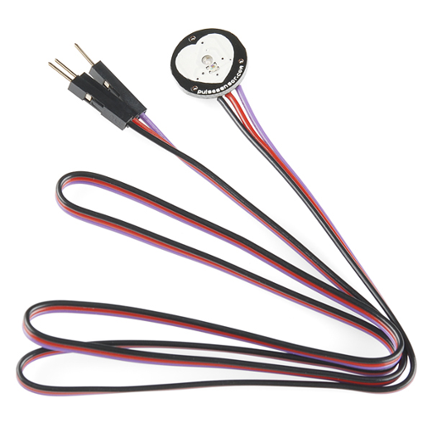
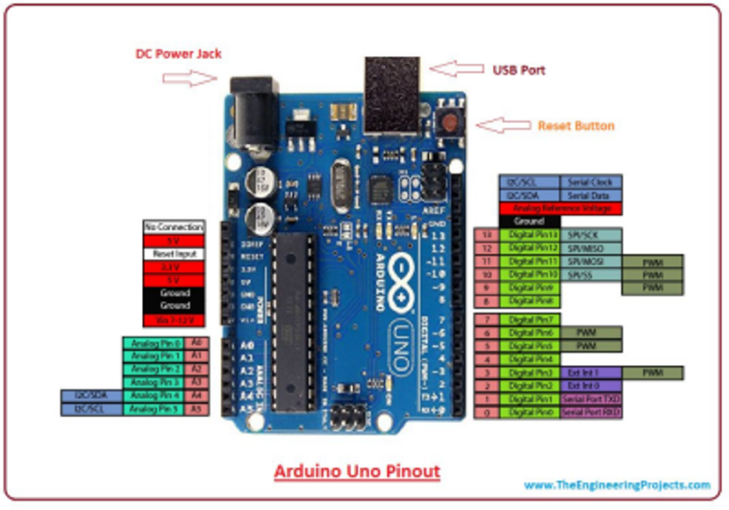
Materials
Arduino Uno
Heart Pulse Sensor.

Slide 9
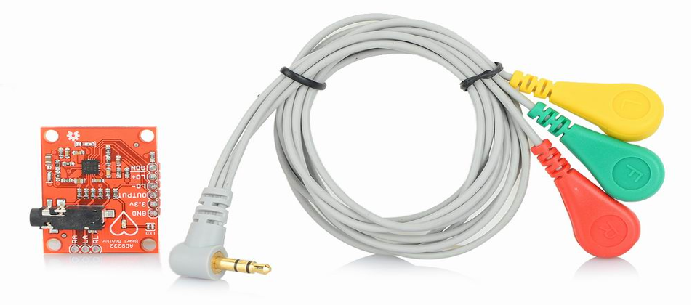
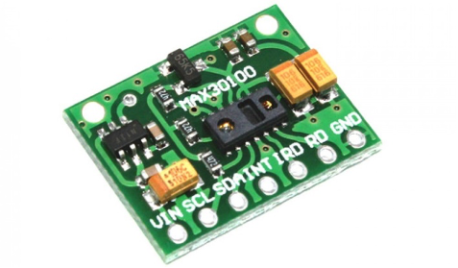
Materials
AD8232 ECG Sensor.
Max30100 SpO2 sensor.

Slide 10
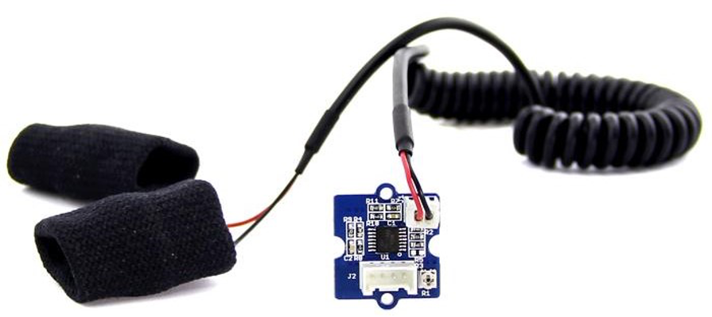
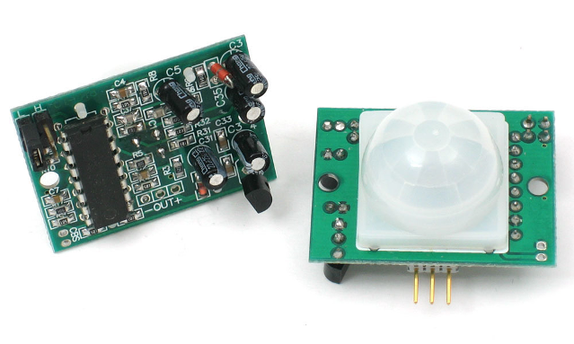
Materials
Galvanic Skin Response(GSR) sensor.
PIR Sensor

Slide 11
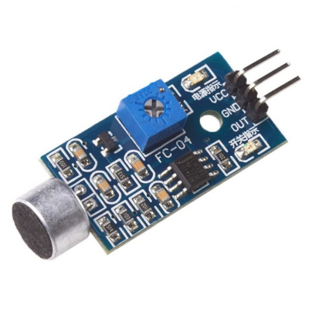
Materials
Sound Sensor

Slide 12
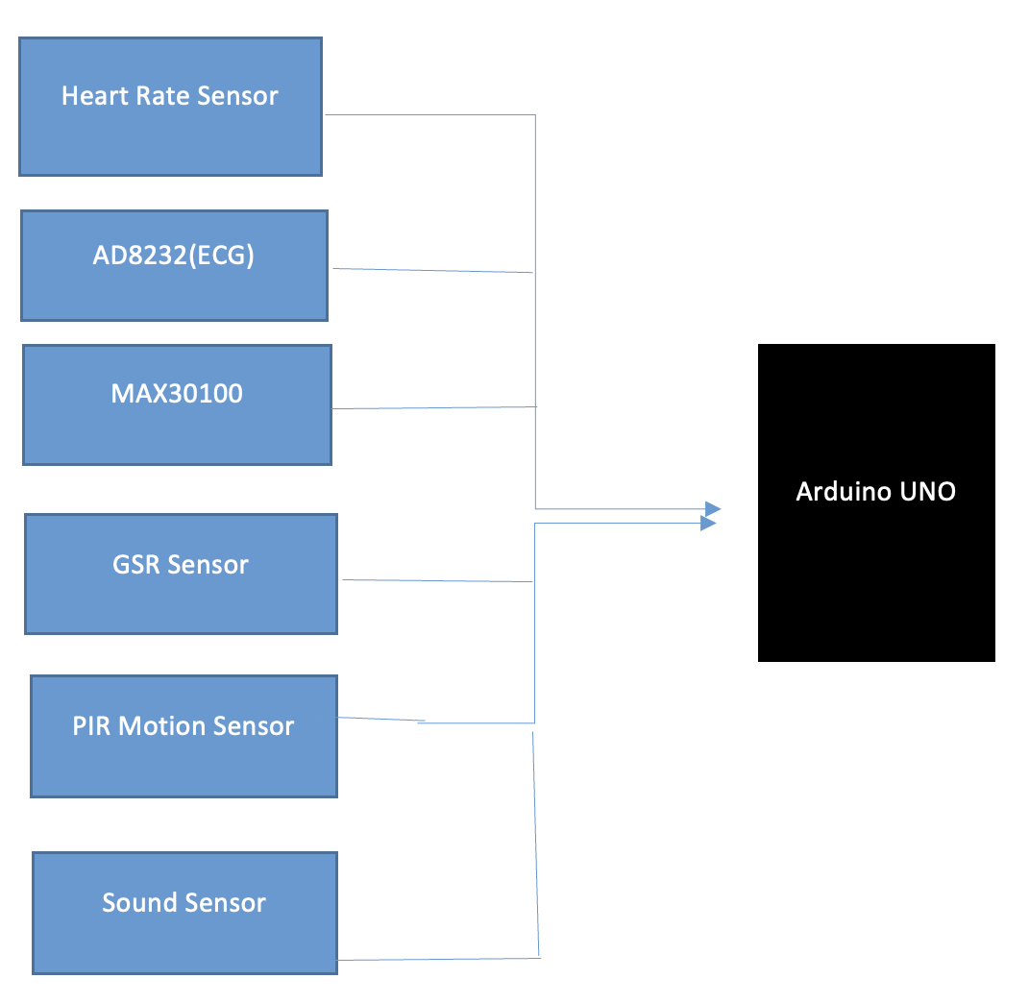
Input Subsystem

Slide 13
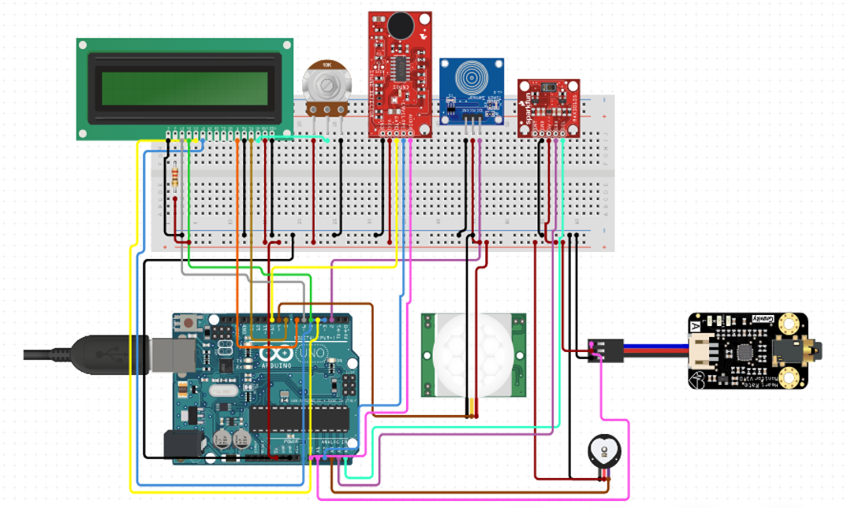
Circuit Diagram of the full system.

Slide 14
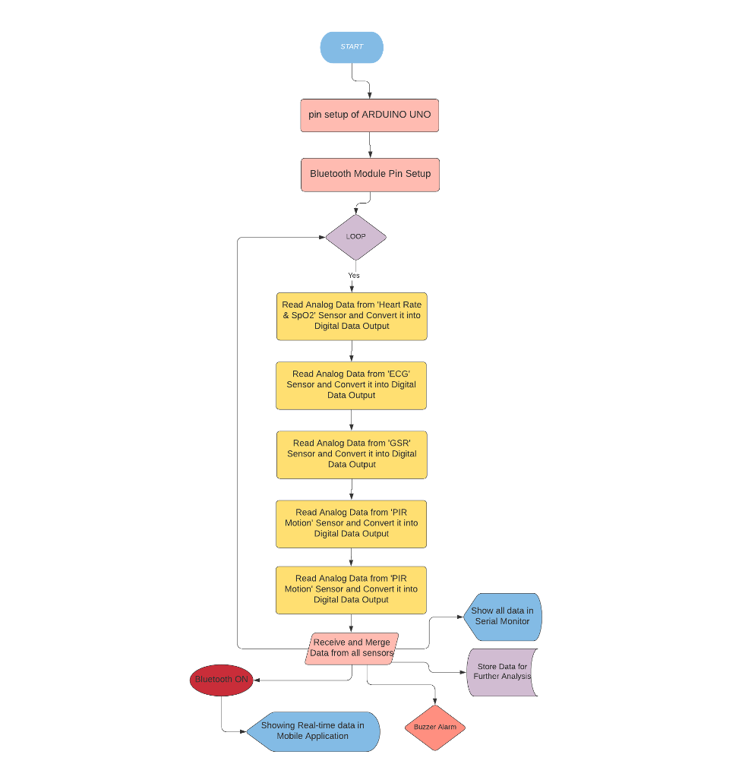
Flow-Chart
of full system.
Diagrams drawn using MS Word
or MS Visio showing flow chart for processing.

Slide 15
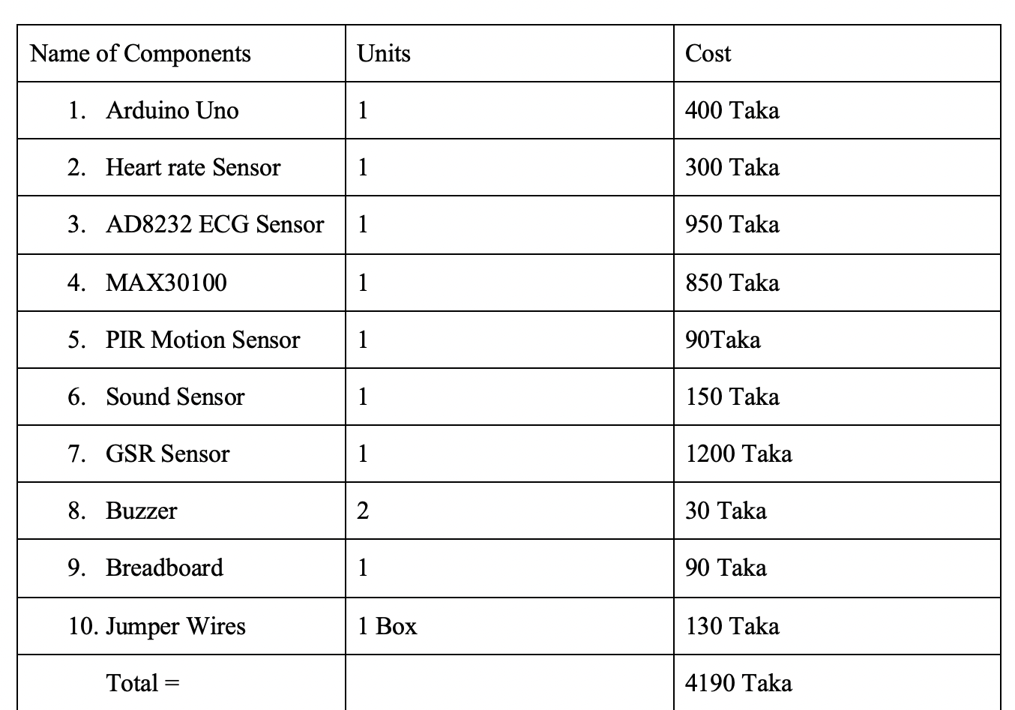
Approximate Cost

Slide 16
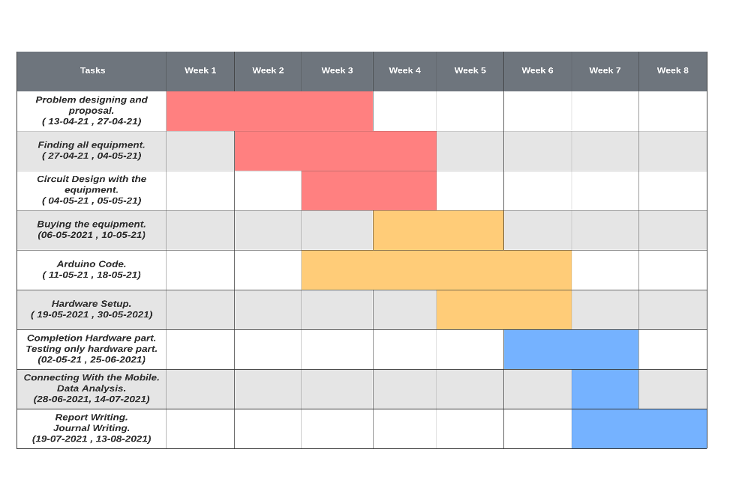
Gantt Chart

Slide 17
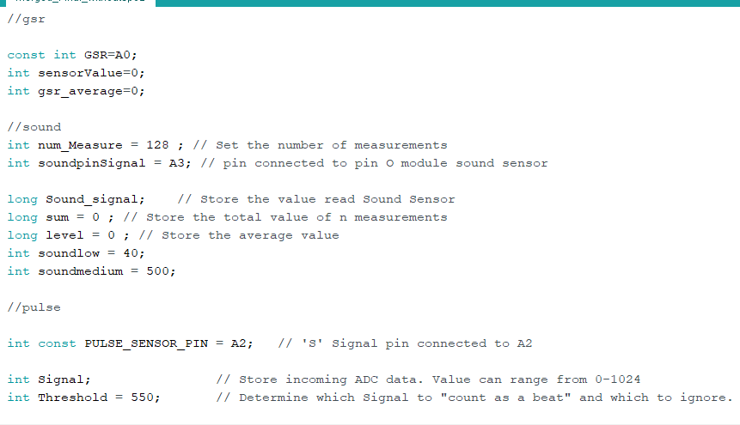
Arduino Code
Part of Arduino
Code to upload
into the circuit.

Slide 18
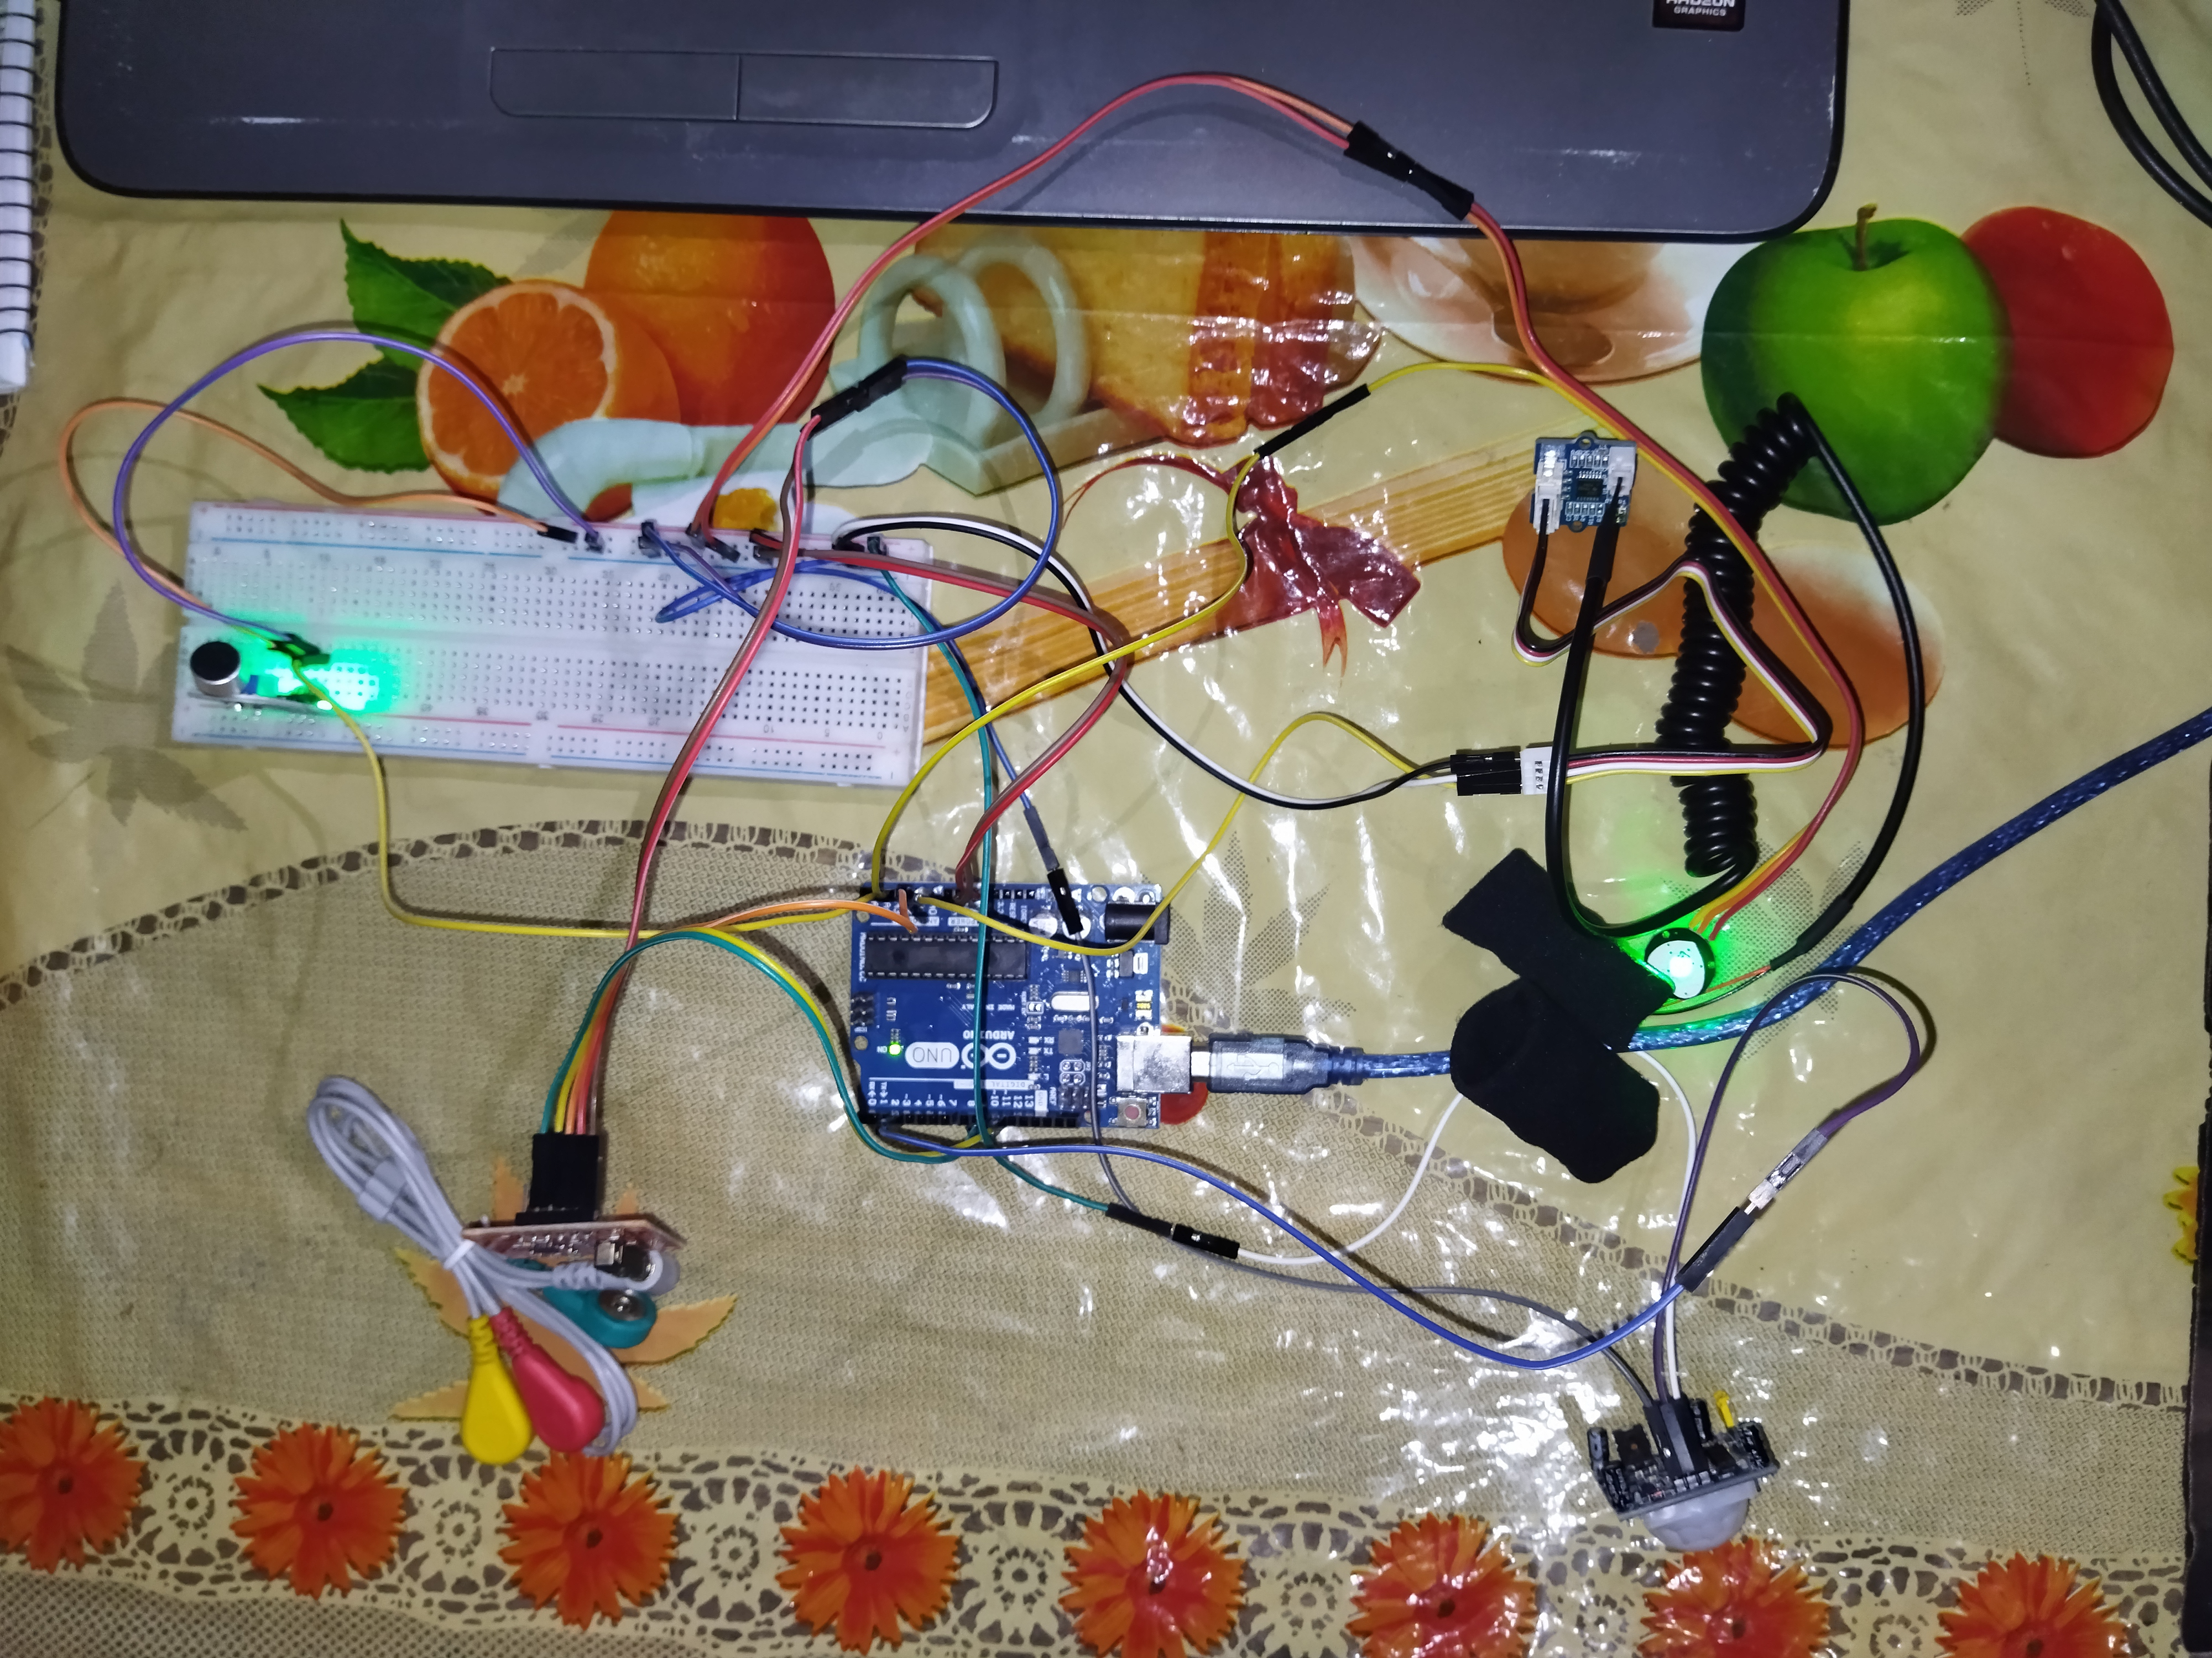
Complete Hardware Setup

Slide 19
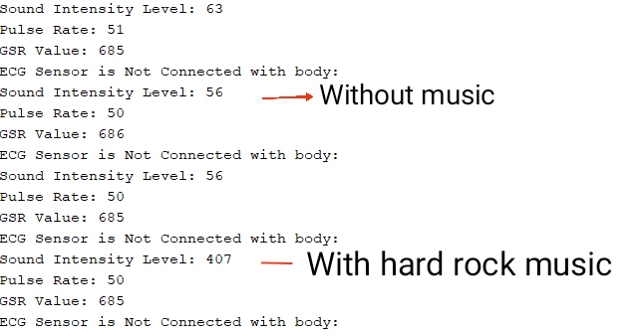
Initial Results

Slide 20
THANK YOU
END

